Slide 1
Lecture 5
Design based on Philosophy (and lots of Learnings)
Case study in decomposition and abstraction - UNIX

Slide 2
Agenda
Unix OS: A Case Study in System Decomposition & Abstraction
Objectives:
Understand how Unix exemplifies system decomposition.
Explore abstractions that simplify complex operations.
Recognize the Unix philosophy's impact on modern computing.

Slide 3
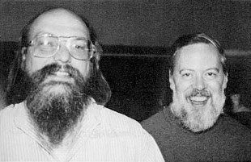
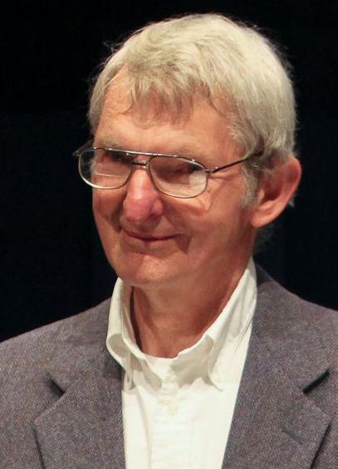
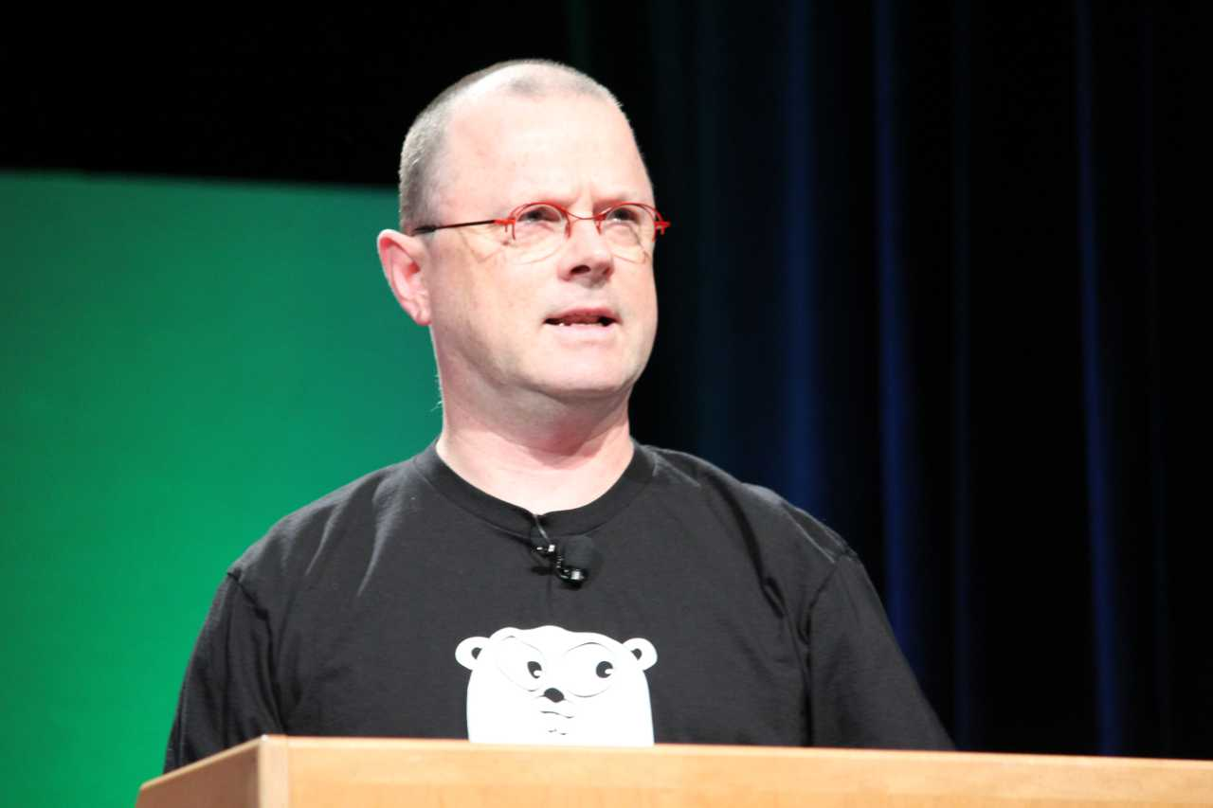
Background on Unix
History: Development by Dennis Ritchie and Ken Thompson (1969-1971)
Based on lessons learned from the MULTICS OS.
He wanted to create an multi-user operating system to run space wars game.
Rewritten in 1975 in a newly created high-level language C
Unprecedented to write OS in HLL at that time
Significance: A pioneering OS that introduced modularity and simplicity.
Emphasis on building simple, short, clear, modular and extensible code that can be easily maintained and repurposed by developers other than creators.
Ken Thompson and Dennis Ritchie
Doug McIlroy
Rob Pike

Slide 4
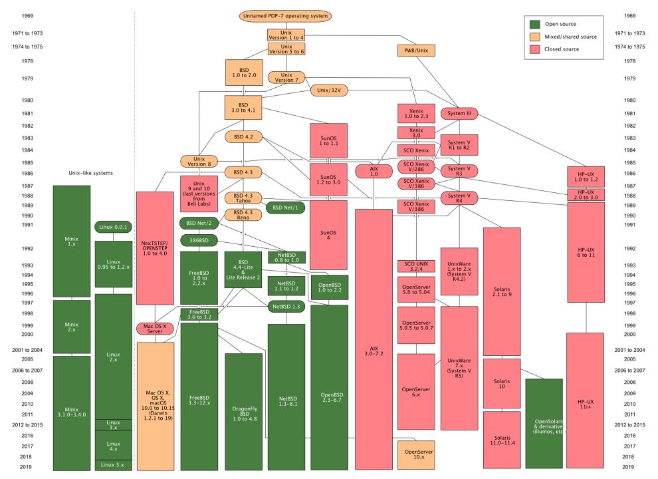
55 years of success

Slide 5
Recap of System Decomposition/Composition
Breaking down a system into manageable parts based on the clear notion of concepts.
Mapping function to form
Conceptual integrity.
During the design, the integrity should not be shattered.
Hiding underlying details to simplify interfaces in deep modules with multiple layers.
Importance in Unix: Enables users to interact with complex functionalities of hardware through a simplified interface.

Slide 6
Origins is Unix Philosophy?
The ‘Unix philosophy’ originated with Ken Thompson's early meditations on how to design a small but capable operating system with a clean service interface.
The Unix philosophy is not a formal design method.
The Unix philosophy (like successful folk traditions in other engineering disciplines) is bottom-up, not top-down. It is pragmatic and grounded in experience.

Slide 7
Unix Philosophy (McIlroy)
Make each program do one thing well. To do a new job, build afresh rather than complicate old programs by adding new features.
Expect the output of every program to become the input to another, as yet unknown, program. Don't clutter output with extraneous information. Avoid stringently columnar or binary input formats. Don't insist on interactive input.
Design and build software, even operating systems, to be tried early, ideally within weeks. Don't hesitate to throw away the clumsy parts and rebuild them.
Use tools in preference to unskilled help to lighten a programming task, even if you have to detour to build the tools and expect to throw some of them out after you've finished using them.
Later summary : Write programs that do one thing and do it well. Write programs to work together. Write programs to handle text streams, because that is a universal interface.

Slide 8
Unix Philosophy (Commander Pike)
Rule 1. You can't tell where a program is going to spend its time. Bottlenecks occur in surprising places, so don't try to second guess and put in a speed hack until you've proven that's where the bottleneck is.
Rule 2. Measure. Don't tune for speed until you've measured, and even then don't unless one part of the code overwhelms the rest.
Rule 3. Fancy algorithms are slow when n is small, and n is usually small. Fancy algorithms have big constants. Until you know that n is frequently going to be big, don't get fancy. (Even if n does get big, use Rule 2 first.)
Rule 4. Fancy algorithms are buggier than simple ones, and they're much harder to implement. Use simple algorithms as well as simple data structures.
Rule 5. Data dominates. If you've chosen the right data structures and organized things well, the algorithms will almost always be self-evident. Data structures, not algorithms, are central to programming.
Rule 6. There is no Rule 6.

Slide 9
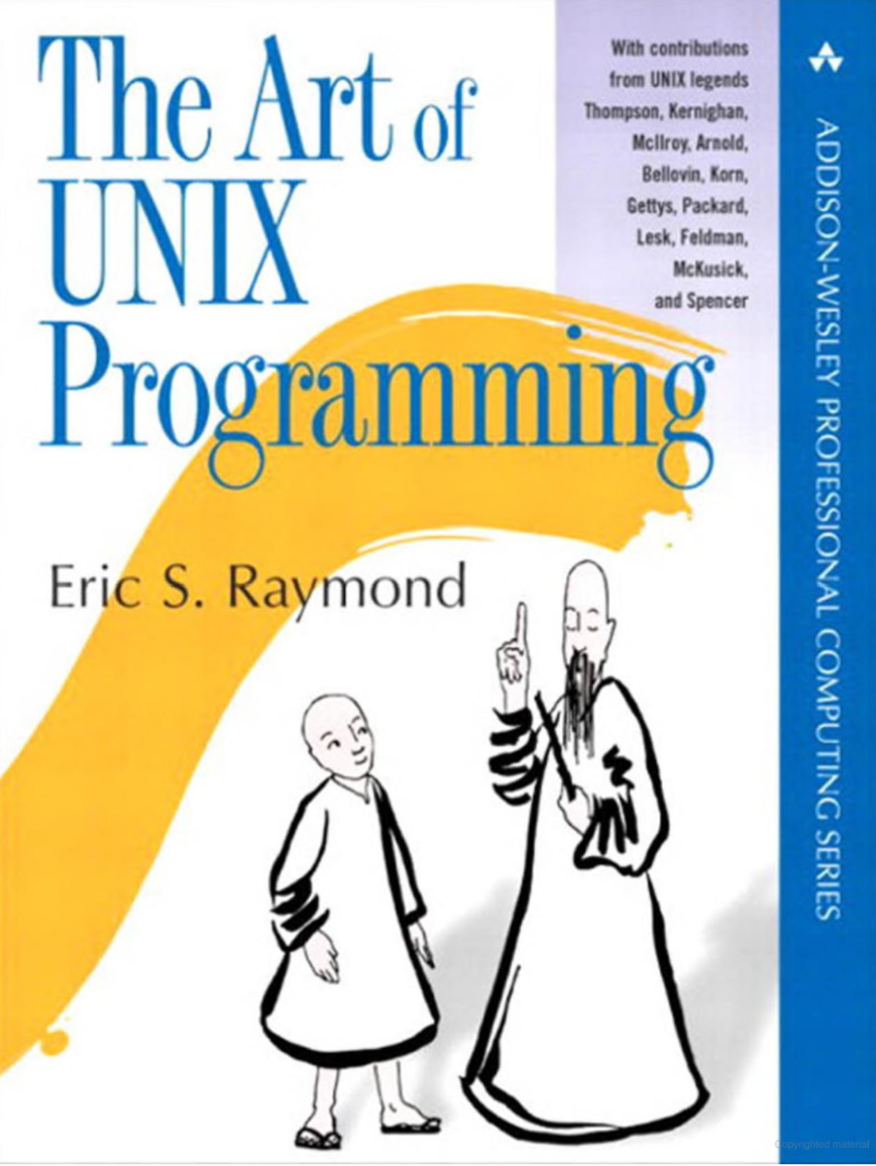
Unix Philosophy (Folklore, Raymond)
Rule of Modularity: Write simple parts connected by clean interfaces.
Rule of Clarity: Clarity is better than cleverness.
Rule of Composition: Design programs to be connected to other programs.
Rule of Separation: Separate policy from mechanism; separate interfaces from engines.
Rule of Simplicity: Design for simplicity; add complexity only where you must.
Rule of Parsimony: Write a big program only when it is clear by demonstration that nothing else will do.
Rule of Transparency: Design for visibility to make inspection and debugging easier.
Rule of Robustness: Robustness is the child of transparency and simplicity.
Rule of Representation: Fold knowledge into data so program logic can be stupid and robust.

Slide 10
Unix Philosophy (Folklore, Raymond)
Rule of Least Surprise: In interface design, always do the least surprising thing.
Rule of Silence: When a program has nothing surprising to say, it should say nothing.
Rule of Repair: When you must fail, fail noisily and as soon as possible.
Rule of Economy: Programmer time is expensive; conserve it in preference to machine time.
Rule of Generation: Avoid hand-hacking; write programs to write programs when you can.
Rule of Optimization: Prototype before polishing. Get it working before you optimize it.
Rule of Diversity: Distrust all claims for “one true way”.
Rule of Extensibility: Design for the future, because it will be here sooner than you think.

Slide 11
Do one thing well
cat does exactly one thing. It concatenates files and displays them on standard output. That’s all it does. It doesn’t do pagination. It doesn’t offer search functionality. It just does exactly what it says on the tin and no more.
true and false are perhaps the best examples of doing one thing well. true does nothing, successfully! false does nothing.
false && echo Hi # does nothing
true && echo Hi # Prints Hi

Slide 12
Worse is Better
Although this idea wasn’t a direct relative of the Unix philosophy, it’s certainly similar.
The idea references the fact that additional features or complexity doesn’t necessarily make things better, and a “worse” project — one with fewer features and less complexity — is actually better because it will tend to be more reliable and usable.
Most of us can recognize this idea in at least one of our projects. We start work on a project but midway though the project we decide that it should have another feature. The feature creep causes the project to be unusable or unreliable, even given its initial simple design goal. An emphasis on simplicity and interoperability helps fight feature creep.

Slide 13
Composition
In Unix, most operations have the ability to read and write to standard output in a well understood textual format. With a few commands, such as | and > we can feed the output of one program to another. Let’s look at some examples:
In this example, we use cat to output the contents of a file and feed the output into wc who can count the number of lines in a file.
cat text.txt | wc -l

Slide 14
Everything is a file
In UNIX everything is a file (or more precisely, everything is a stream of bytes). This means that the same APIs/commands can be used for reading a CD-ROM drive, writing a network socket or finding out CPU info.
For example, the entire /proc file system on Linux isn’t really files — it’s a dynamic view of information that’s exposed as a bunch of file descriptors.

Slide 15
Some examples:
cat /proc/cpuinfo # Displays your CPU info exposed as a file
echo "This is the next line in the log" >> log.file # Redirects output into a file called log.file Example in code

Slide 16
A simple program
Does one thing
Does it well
No versioning problems
Can be used by any program written in any language

Slide 17
func upper(f *os.File) {
input := bufio.NewScanner(f)
for input.Scan() {
fmt.Println(strings.ToUpper(input.Text()))
}
}
func main() {
files := os.Args[1:]
if len(files) == 0 {
upper(os.Stdin)
} else {
for _, file := range files {
f, err := os.Open(file)
if err != nil {
fmt.Fprintf(os.Stderr, "%s: %v\n", os.Args[0], err)
continue
}
upper(f)
f.Close()
}
}
}

Slide 18
Another example
Does one thing
Does it well
No versioning problems
Can be used by any program written in any language

Slide 19
func split(f *os.File) {
input := bufio.NewScanner(f)
for input.Scan() {
lines := strings.Split(input.Text(), " ")
for _, line := range lines {
fmt.Println(line)
}
}
}
func main() {
files := os.Args[1:]
if len(files) == 0 {
split(os.Stdin)
} else {
for _, file := range files {
f, err := os.Open(file)
if err != nil {
fmt.Fprintf(os.Stderr, "%s: %v\n", os.Args[0], err)
continue
}
split(f)
f.Close()
}
}
}

Slide 20
Composing Programs
We build complex programs from simple ones
#!/bin/bash
uppercase | split
We build complex programs from simple ones
cat text.txt | uppercase | split

Slide 21
Building Technical Capital
cat text.txt text2.txt | uppercase | split | sort | uniq
We build in a short while a program that does the majority of the work of a spell checker
Pros:
Less lines of code
Less buggy
More efficient
Short build time

Slide 22
Difficulties
Requires discipline - It requires much more time in planning for the future of the project
Requires experience - To create a good plan, you have to know where the difficulties in software development are. (i.e Communication between teams)
It's not a complete science - There's no hard science telling us how to implement the UNIX philosophy. May depend on the size of the project or future expectations

Slide 23
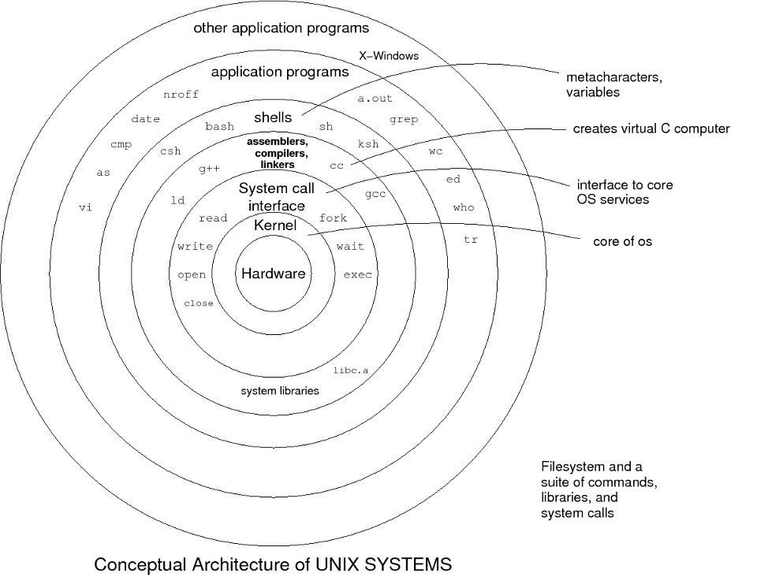
Unix Architecture Overview
Kernel and User Space: Separation of concerns.
Core Components: File system, process management, and inter-process communication.

Slide 24
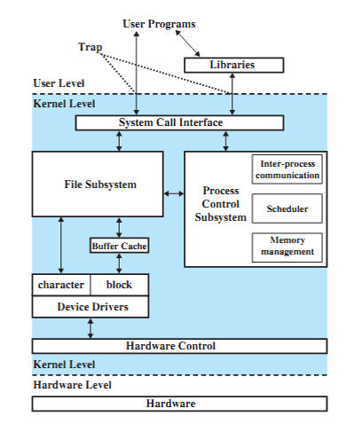
Unix Architecture – Layered View
Three levels: user level, kernel level, hardware level
File subsystem: manages file, allocating file space, retrieving data for users etc.
Hardware control: responsible for handling interrupts and for communicating with the machine.
File subsystem and process control subsystem interact when loading a file into memory for execution.
The memory management module controls allocation of memory.
Scheduler module allocates CPU to the processes.

Slide 25
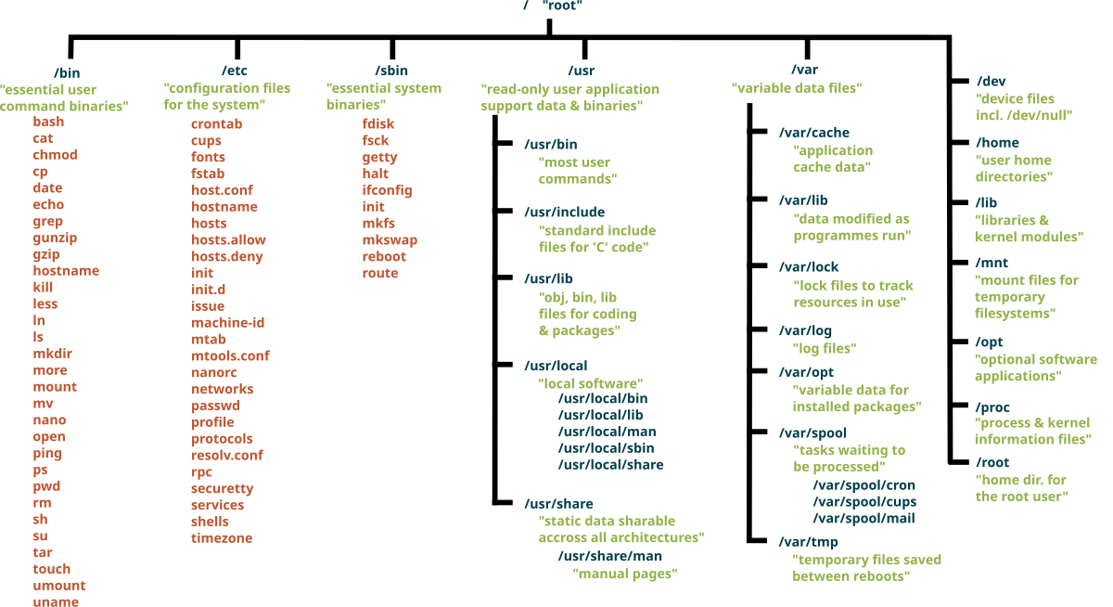
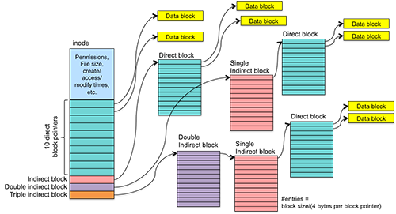
Unix File System as an Abstraction
Uniform Interface: Treats everything as a file.
Benefit: Simplifies access to different types of resources (files, devices).
Example: Accessing files and devices with the same system calls.

Slide 26
Decomposition in the File System
Hierarchical Directory Structure: Organizes files logically.
Special Files: Devices represented as files, ensuring consistency.

Slide 27
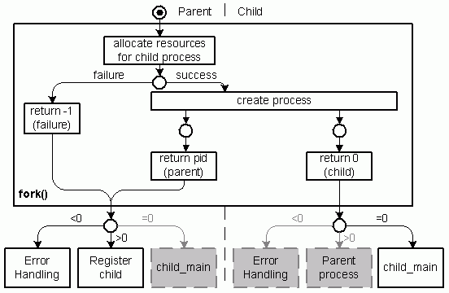
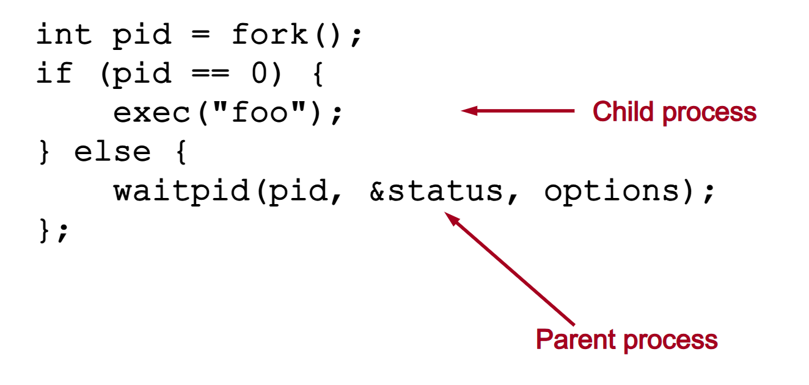
Process Management as a Decomposition Strategy
The Fork and Exec Model: Separation of process creation (`fork`) and program execution (`exec`).
Benefits: Flexibility and simplicity in managing processes.
Fork: Duplicates the process, creating a child process.
Exec: Loads a new program, replacing the process’s memory.
Example: Shell operations creating new processes for each command.

Slide 28
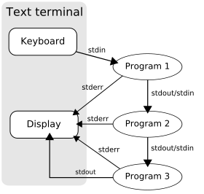
Pipes and Redirection: Abstraction in Inter-Process Communication
Pipes: Allows output of one process to be input to another.
Example: `cat file.txt | grep 'search' | sort`
Benefit: Enables composition of small programs to perform complex tasks.

Slide 29
Decomposition in Inter-Process Communication
Message Passing vs. Shared Memory: Different methods for communication.
Unix Choice: Focus on pipes for simplicity and safety.

Slide 30
Modularity Through Command Line Tools
Single Responsibility Principle: Each command does one job.
Example Commands: `ls`, `grep`, `sort`, `awk`
Benefit: Allows chaining of commands for complex operations.

Slide 31
Filters and Pipelines as Abstraction Mechanisms
Filters: Commands that read from standard input, perform operations, and write to standard output.
Pipeline: Connecting multiple filters using pipes for complex workflows.

Slide 32
Device Management Abstraction
Character and Block Devices: Special files to interact with devices.
Uniform Access: Treating devices as files simplifies user interaction.
Files can read/write blocks of data.
Character and block devices.
Pseudo devices (e.g., /dev/null, /dev/random).

Slide 33
Error Handling Abstractions
Return Codes: Indicates success or failure of commands.
Standardized Error Handling: Simplifies debugging and consistency across commands.
$ errno -ls
EPERM 1 Operation not permitted
ENOENT 2 No such file or directory
ESRCH 3 No such process
EINTR 4 Interrupted system call
EIO 5 Input/output error
...

Slide 34
Shell as an Abstraction Layer
Interface for Users: Hides kernel complexity.
Command Interpretation: Translates commands into system calls.
Example: Typing `ls` results in a series of kernel operations without user awareness of underlying details.

Slide 35
The Unix Philosophy as Design Tactics
Key Principles: Small, modular, and composable.
Influence on Decomposition and Abstraction: Simple tools can be combined for greater functionality.

Slide 36
Modern Implications of Unix Design
Portability: Unix systems adapted to many platforms due to modularity.
Influence on Linux and BSD: Unix architecture still underpins modern OS designs.

Slide 37
Recap and Key Takeaways
Decomposition Techniques in Unix: Modules for file management, processes, and IPC.
Abstraction Examples in Unix: “Everything is a file” concept, shell interface, pipes.
Unix Legacy in System Design: Continuing influence on software architecture principles.

Slide 38
Homework
How might Unix principles apply to modern software design?
What are the limitations of Unix-style modularity?

Slide 39
Backup

Slide 40
Rule of Modularity: Write simple parts connected by clean interfaces.
As Brian Kernighan once observed, “Controlling complexity is the essence of computer programming” [Kernighan-Plauger]. Debugging dominates development time, and getting a working system out the door is usually less a result of brilliant design than it is of managing not to trip over your own feet too many times.
Assemblers, compilers, flowcharting, procedural programming, structured programming, artificial intelligence, fourth-generation languages, object orientation, and software-development methodologies without number have been touted and sold as a cure for this problem. All have failed as cures, if only because they ‘succeeded’ by escalating the normal level of program complexity to the point where (once again) human brains could barely cope. As Fred Brooks famously observed [Brooks], there is no silver bullet.
The only way to write complex software that won't fall on its face is to hold its global complexity down — to build it out of simple parts connected by well-defined interfaces, so that most problems are local and you can have some hope of upgrading a part without breaking the whole.

Slide 41
Rule of Clarity: Clarity is better than cleverness.
Because maintenance is so important and so expensive, write programs as if the most important communication they do is not to the computer that executes them but to the human beings who will read and maintain the source code in the future (including yourself).
In the Unix tradition, the implications of this advice go beyond just commenting your code. Good Unix practice also embraces choosing your algorithms and implementations for future maintainability. Buying a small increase in performance with a large increase in the complexity and obscurity of your technique is a bad trade — not merely because complex code is more likely to harbor bugs, but also because complex code will be harder to read for future maintainers.
Code that is graceful and clear, on the other hand, is less likely to break — and more likely to be instantly comprehended by the next person to have to change it. This is important, especially when that next person might be yourself some years down the road.

Slide 42
Rule of Composition: Design programs to be connected with other programs.
It's hard to avoid programming overcomplicated monoliths if none of your programs can talk to each other.
Unix tradition strongly encourages writing programs that read and write simple, textual, stream-oriented, device-independent formats. Under classic Unix, as many programs as possible are written as simple filters, which take a simple text stream on input and process it into another simple text stream on output.
Despite popular mythology, this practice is favored not because Unix programmers hate graphical user interfaces. It's because if you don't write programs that accept and emit simple text streams, it's much more difficult to hook the programs together.
Text streams are to Unix tools as messages are to objects in an object-oriented setting. The simplicity of the text-stream interface enforces the encapsulation of the tools. More elaborate forms of inter-process communication, such as remote procedure calls, show a tendency to involve programs with each others' internals too much.
To make programs composable, make them independent. A program on one end of a text stream should care as little as possible about the program on the other end. It should be made easy to replace one end with a completely different implementation without disturbing the other.

Slide 43
Rule of Separation: Separate policy from mechanism; separate interfaces from engines.
In our discussion of what Unix gets wrong, we observed that the designers of X made a basic decision to implement “mechanism, not policy”—to make X a generic graphics engine and leave decisions about user-interface style to toolkits and other levels of the system. We justified this by pointing out that policy and mechanism tend to mutate on different timescales, with policy changing much faster than mechanism. Fashions in the look and feel of GUI toolkits may come and go, but raster operations and compositing are forever.
Thus, hardwiring policy and mechanism together has two bad effects: It makes policy rigid and harder to change in response to user requirements, and it means that trying to change policy has a strong tendency to destabilize the mechanisms.
On the other hand, by separating the two we make it possible to experiment with new policy without breaking mechanisms. We also make it much easier to write good tests for the mechanism (policy, because it ages so quickly, often does not justify the investment).
This design rule has wide application outside the GUI context. In general, it implies that we should look for ways to separate interfaces from engines.
One way to effect that separation is, for example, to write your application as a library of C service routines that are driven by an embedded scripting language, with the application flow of control written in the scripting language rather than C. A classic example of this pattern is the Emacs editor, which uses an embedded Lisp interpreter to control editing primitives written in C.

Slide 44
Rule of Simplicity: Design for simplicity; add complexity only where you must.
Many pressures tend to make programs more complicated (and therefore more expensive and buggy). One such pressure is technical machismo. Programmers are bright people who are (often justly) proud of their ability to handle complexity and juggle abstractions. Often they compete with their peers to see who can build the most intricate and beautiful complexities. Just as often, their ability to design outstrips their ability to implement and debug, and the result is expensive failure.
The notion of “intricate and beautiful complexities” is almost an oxymoron. Unix programmers vie with each other for “simple and beautiful” honors — a point that's implicit in these rules, but is well worth making overt. -- Doug McIlroy
Even more often (at least in the commercial software world) excessive complexity comes from project requirements that are based on the marketing fad of the month rather than the reality of what customers want or software can actually deliver. Many a good design has been smothered under marketing's pile of “checklist features” — features that, often, no customer will ever use. And a vicious circle operates; the competition thinks it has to compete with chrome by adding more chrome. Pretty soon, massive bloat is the industry standard and everyone is using huge, buggy programs not even their developers can love.
Either way, everybody loses in the end.
The only way to avoid these traps is to encourage a software culture that knows that small is beautiful, that actively resists bloat and complexity: an engineering tradition that puts a high value on simple solutions, that looks for ways to break program systems up into small cooperating pieces, and that reflexively fights attempts to gussy up programs with a lot of chrome (or, even worse, to design programs around the chrome).

Slide 45
Rule of Parsimony: Write a big program only when it is clear by demonstration that nothing else will do.
‘Big’ here has the sense both of large in volume of code and of internal complexity. Allowing programs to get large hurts maintainability. Because people are reluctant to throw away the visible product of lots of work, large programs invite overinvestment in approaches that are failed or suboptimal.

Slide 46
Rule of Transparency: Design for visibility to make inspection and debugging easier.
Because debugging often occupies three-quarters or more of development time, work done early to ease debugging can be a very good investment. A particularly effective way to ease debugging is to design for transparency and discoverability.
A software system is transparent when you can look at it and immediately understand what it is doing and how. It is discoverable when it has facilities for monitoring and display of internal state so that your program not only functions well but can be seen to function well.
Designing for these qualities will have implications throughout a project. At minimum, it implies that debugging options should not be minimal afterthoughts. Rather, they should be designed in from the beginning — from the point of view that the program should be able to both demonstrate its own correctness and communicate to future developers the original developer's mental model of the problem it solves.
For a program to demonstrate its own correctness, it needs to be using input and output formats sufficiently simple so that the proper relationship between valid input and correct output is easy to check.

Slide 47
Rule of Robustness: Robustness is the child of transparency and simplicity.
Software is said to be robust when it performs well under unexpected conditions which stress the designer's assumptions, as well as under normal conditions.
Most software is fragile and buggy because most programs are too complicated for a human brain to understand all at once. When you can't reason correctly about the guts of a program, you can't be sure it's correct, and you can't fix it if it's broken.
It follows that the way to make robust programs is to make their internals easy for human beings to reason about. There are two main ways to do that: transparency and simplicity.
For robustness, designing in tolerance for unusual or extremely bulky inputs is also important. Bearing in mind the Rule of Composition helps; input generated by other programs is notorious for stress-testing software (e.g., the original Unix C compiler reportedly needed small upgrades to cope well with Yacc output). The forms involved often seem useless to humans. For example, accepting empty lists/strings/etc., even in places where a human would seldom or never supply an empty string, avoids having to special-case such situations when generating the input mechanically.
One very important tactic for being robust under odd inputs is to avoid having special cases in your code. Bugs often lurk in the code for handling special cases, and in the interactions among parts of the code intended to handle different special cases.

Slide 48
Rule of Representation: Fold knowledge into data, so program logic can be stupid and robust.
Even the simplest procedural logic is hard for humans to verify, but quite complex data structures are fairly easy to model and reason about. To see this, compare the expressiveness and explanatory power of a diagram of (say) a fifty-node pointer tree with a flowchart of a fifty-line program. Or, compare an array initializer expressing a conversion table with an equivalent switch statement. The difference in transparency and clarity is dramatic. See Rob Pike's Rule 5.
Data is more tractable than program logic. It follows that where you see a choice between complexity in data structures and complexity in code, choose the former. More: in evolving a design, you should actively seek ways to shift complexity from code to data.
The Unix community did not originate this insight, but a lot of Unix code displays its influence. The C language's facility at manipulating pointers, in particular, has encouraged the use of dynamically-modified reference structures at all levels of coding from the kernel upward. Simple pointer chases in such structures frequently do duties that implementations in other languages would instead have to embody in more elaborate procedures.

Slide 49
Rule of Least Surprise: In interface design, always do the least surprising thing.
The easiest programs to use are those that demand the least new learning from the user — or, to put it another way, the easiest programs to use are those that most effectively connect to the user's pre-existing knowledge.
Therefore, avoid gratuitous novelty and excessive cleverness in interface design. If you're writing a calculator program, ‘+’ should always mean addition! When designing an interface, model it on the interfaces of functionally similar or analogous programs with which your users are likely to be familiar.
Pay attention to your expected audience. They may be end users, they may be other programmers, or they may be system administrators. What is least surprising can differ among these groups.
Pay attention to tradition. The Unix world has rather well-developed conventions about things like the format of configuration and run-control files, command-line switches, and the like. These traditions exist for a good reason: to tame the learning curve. Learn and use them.

Slide 50
Rule of Silence: When a program has nothing surprising to say, it should say nothing.
One of Unix's oldest and most persistent design rules is that when a program has nothing interesting or surprising to say, it should shut up. Well-behaved Unix programs do their jobs unobtrusively, with a minimum of fuss and bother. Silence is golden.
This “silence is golden” rule evolved originally because Unix predates video displays. On the slow printing terminals of 1969, each line of unnecessary output was a serious drain on the user's time. That constraint is gone, but excellent reasons for terseness remain.

Slide 51
Rule of Repair: Repair what you can — but when you must fail, fail noisily and as soon as possible.
Software should be transparent in the way that it fails, as well as in normal operation. It's best when software can cope with unexpected conditions by adapting to them, but the worst kinds of bugs are those in which the repair doesn't succeed and the problem quietly causes corruption that doesn't show up until much later.
Therefore, write your software to cope with incorrect inputs and its own execution errors as gracefully as possible. But when it cannot, make it fail in a way that makes diagnosis of the problem as easy as possible.

Slide 52
Rule of Economy: Programmer time is expensive; conserve it in preference to machine time.
In the early minicomputer days of Unix, this was still a fairly radical idea (machines were a great deal slower and more expensive then). Nowadays, with every development shop and most users (apart from the few modeling nuclear explosions or doing 3D movie animation) awash in cheap machine cycles, it may seem too obvious to need saying.
Somehow, though, practice doesn't seem to have quite caught up with reality. If we took this maxim really seriously throughout software development, most applications would be written in higher-level languages like Perl, Tcl, Python, Java, Lisp and even shell — languages that ease the programmer's burden by doing their own memory management (see [Ravenbrook]).
And indeed this is happening within the Unix world, though outside it most applications shops still seem stuck with the old-school Unix strategy of coding in C (or C++). Later in this book we'll discuss this strategy and its tradeoffs in detail.
One other obvious way to conserve programmer time is to teach machines how to do more of the low-level work of programming. This leads to...

Slide 53
Rule of Generation: Avoid hand-hacking; write programs to write programs when you can.
Human beings are notoriously bad at sweating the details. Accordingly, any kind of hand-hacking of programs is a rich source of delays and errors. The simpler and more abstracted your program specification can be, the more likely it is that the human designer will have gotten it right. Generated code (at every level) is almost always cheaper and more reliable than hand-hacked.
We all know this is true (it's why we have compilers and interpreters, after all) but we often don't think about the implications. High-level-language code that's repetitive and mind-numbing for humans to write is just as productive a target for a code generator as machine code. It pays to use code generators when they can raise the level of abstraction — that is, when the specification language for the generator is simpler than the generated code, and the code doesn't have to be hand-hacked afterwards.
In the Unix tradition, code generators are heavily used to automate error-prone detail work. Parser/lexer generators are the classic examples; makefile generators and GUI interface builders are newer ones.

Slide 54
Rule of Optimization: Prototype before polishing. Get it working before you optimize it.
The most basic argument for prototyping first is Kernighan & Plauger's; “90% of the functionality delivered now is better than 100% of it delivered never”. Prototyping first may help keep you from investing far too much time for marginal gains.
For slightly different reasons, Donald Knuth (author of The Art Of Computer Programming, one of the field's few true classics) popularized the observation that “Premature optimization is the root of all evil”.[11] And he was right.

Slide 55
Rule of Diversity: Distrust all claims for “one true way”.
Even the best software tools tend to be limited by the imaginations of their designers. Nobody is smart enough to optimize for everything, nor to anticipate all the uses to which their software might be put. Designing rigid, closed software that won't talk to the rest of the world is an unhealthy form of arrogance.
Therefore, the Unix tradition includes a healthy mistrust of “one true way” approaches to software design or implementation. It embraces multiple languages, open extensible systems, and customization hooks everywhere.

Slide 56
Rule of Extensibility: Design for the future, because it will be here sooner than you think.
If it is unwise to trust other people's claims for “one true way”, it's even more foolish to believe them about your own designs. Never assume you have the final answer. Therefore, leave room for your data formats and code to grow; otherwise, you will often find that you are locked into unwise early choices because you cannot change them while maintaining backward compatibility.

Slide 57

GNU is not Unix
Started by Richard Stallman in 1983 to foster cooperation among computer users (by the time, most of SW was proprietary).
A collection of “free” (as in “free speech” and not “free beer”: the users have the freedom to run, copy, distribute, study, change and improve the software) software tools and applications.
Note that open-source and free software are very different.
By 1992, when Linux kernel was made free, GNU system resulted in a complete operating system.

